Slide 1
Vulnerability Assessment and Penetration Testing (VAPT)
of a Web Application using Kali Linux and DVWA
USN : 1MS23CY024 Name: Jalihal Abhay
1MS23CY068 V SRAVAN REDDY
1MS23CY073 Vignesh K

Slide 2
Problem Statement / Objective :
Problem Statement
Web applications are widely used for services such as banking, e-commerce, healthcare, and government portals. However, insecure coding practices and poor security configurations often introduce vulnerabilities that attackers can exploit.
Objective
The objective of this experiment is to:
• Perform Vulnerability Assessment and Penetration Testing (VAPT) on a vulnerable web application
• Identify common web application vulnerabilities
• Demonstrate exploitation using penetration testing tools
• Understand the security risks associated with vulnerable applications
• Suggest mitigation strategies to secure web applications
System Tested
Web Application: DVWA
Environment: Ubuntu Linux Server
Testing Platform: Kali Linux

Slide 3
Lab Environment Setup :
Testing Environment
Attacker Machine:
• Kali Linux
• Contains penetration testing tools
Target Machine:
• Ubuntu Linux
• Hosts DVWA web application
Virtualization Platform:
• VMware Workstation
Network Configuration
• Host-Only Network
Architecture:
Kali Linux (Attacker)
↓
Host-Only Network
↓
Ubuntu Server
↓
DVWA Web Application
IP Configuration Example
Kali Linux IP: 192.168.56.101
Ubuntu Server IP: 192.168.56.102

Slide 4
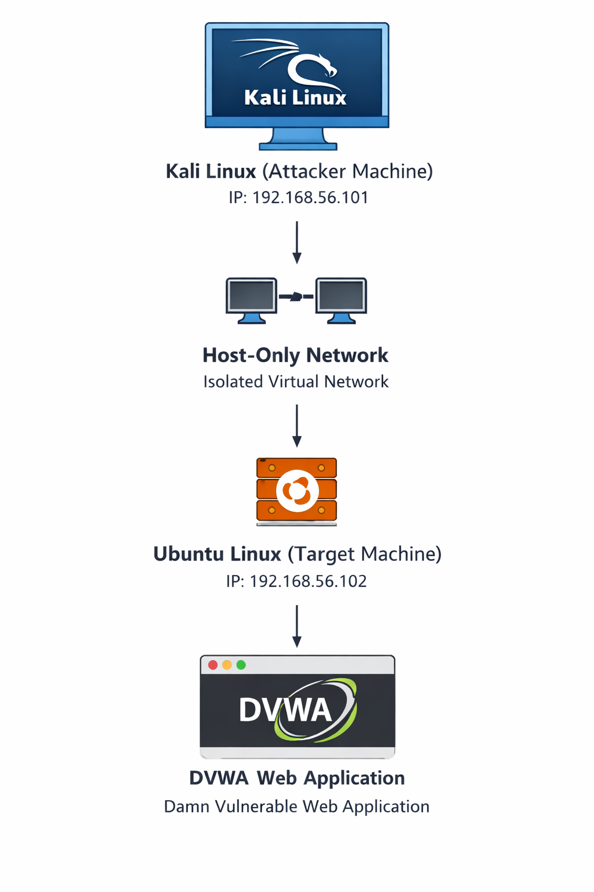
Network diagram :

Slide 5
Tools Used
Tool | Purpose
Nmap | Network scanning and port discovery
Nikto | Web server vulnerability scanner
Hydra | Password brute-force tool
SQLMap | Automated SQL injection exploitation
Nmap
• Identifies open ports and services
• Used for network reconnaissance
Example command
nmap -sV 192.168.56.102
Nikto
• Scans web servers for vulnerabilities
• Detects outdated software and misconfigurations
Example command
nikto -h http://192.168.56.102

Slide 6
Hydra
• Performs password brute-force attacks
• Used to break weak authentication systems
Example command
hydra -l admin -P passwords.txt 192.168.56.102
SQLMap
• Automates SQL Injection attacks
• Extracts database information
Example command
sqlmap -u "http://192.168.56.102/dvwa/vulnerabilities/sqli"

Slide 7
Methodology :
Penetration Testing Lifecycle
1️⃣ Reconnaissance
• Gather information about target system
2️⃣ Scanning
• Identify open ports and services using Nmap
3️⃣ Vulnerability Analysis
• Detect web vulnerabilities using Nikto
4️⃣ Exploitation
• Exploit vulnerabilities using Hydra and SQLMap
5️⃣ Post-Exploitation
• Evaluate impact of the attack

Slide 8
Vulnerabilities Discovered :
Vulnerability | Severity | Tool
SQL Injection | High | SQLMap
Weak Authentication | High | Hydra
Missing Security Headers | Medium | Nikto
Open Ports | Low | Nmap
Description:
SQL Injection
• Allows attackers to access database data
Weak Authentication
• Enables unauthorized login
Missing Security Headers
• Increases risk of web attacks
Open Ports
• Exposes services to attacker

Slide 9
Exploitation Demonstration :
Step 1 — Port Scanning
nmap -sV 192.168.56.102
Result
• HTTP port 80 discovered
Step 2 — Web Vulnerability Scan
nikto -h http://192.168.56.102
Result
• Identified server vulnerabilities
Step 3 — Password Brute Force
hydra -l admin -P passwords.txt 192.168.56.102
Result
• Weak credentials discovered
Step 4 — SQL Injection
sqlmap -u "http://192.168.56.102/dvwa/vulnerabilities/sqli"
Result
• Database tables extracted

Slide 10
Risk Assessment
Risk | Impact
Unauthorized Access | Account compromise
Data Theft | Leakage of sensitive data
System Compromise | Full system control
Reputation Damage | Loss of customer trust
Severity Levels:
Critical
High
Medium
Low

Slide 11
Mitigation & Recommendations :
Vulnerability | Mitigation
SQL Injection | Use prepared SQL statements
Weak Passwords | Enforce strong password policy
Missing Security Headers | Implement HTTP security headers
Open Ports | Disable unused services
Additional Security Measures
• Input validation
• Web Application Firewall (WAF)
• Regular VAPT testing
• Secure coding practices

Slide 12
Conclusion :
• VAPT helps identify vulnerabilities in web applications.
• DVWA provided a safe environment for penetration testing.
• Tools like Nmap, Nikto, Hydra, and SQLMap helped discover and exploit vulnerabilities.
• Security testing helps organizations improve system protection.
• Regular penetration testing is essential for maintaining cybersecurity.

Slide 13
THANK YOU

